Slide 1









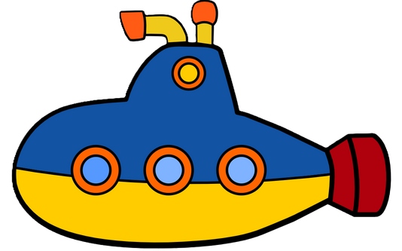


MSIS2433.P11.CTTT
Huỳnh Quốc Triệu-22521532
Nguyễn Thúy Hiền-22520421
Start
1

Slide 2


List of Contents
1. Introduction
2. Analysis and Design
3. Development
4. Special Features
5. Evaluation
2

Slide 3

Introduction
3

Slide 4



Introduction
Doodle Jump
Quack Up
Classic game
Basic gameplay
Simple graphic
New interface
More function
Enhanced gameplay
4

Slide 5
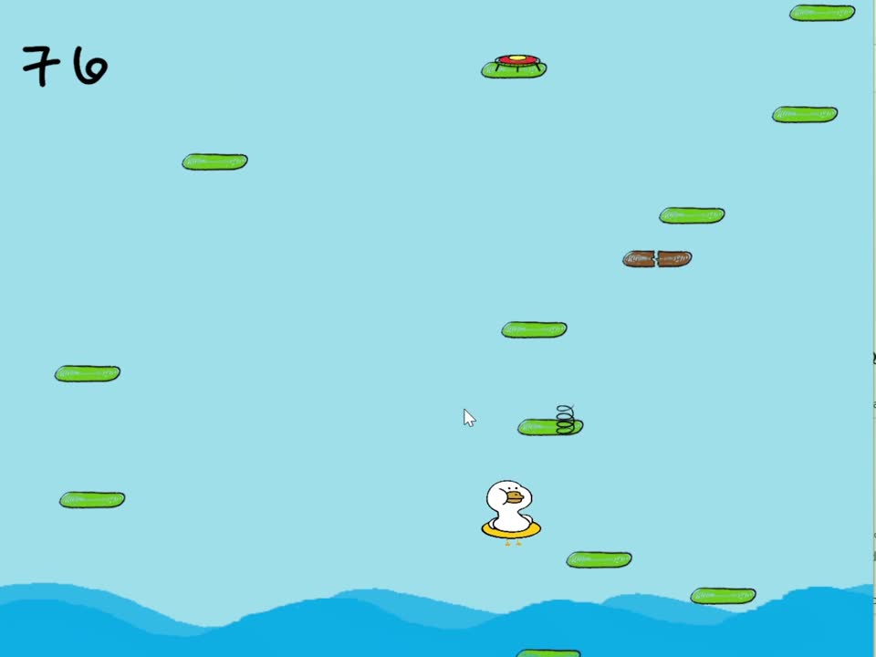
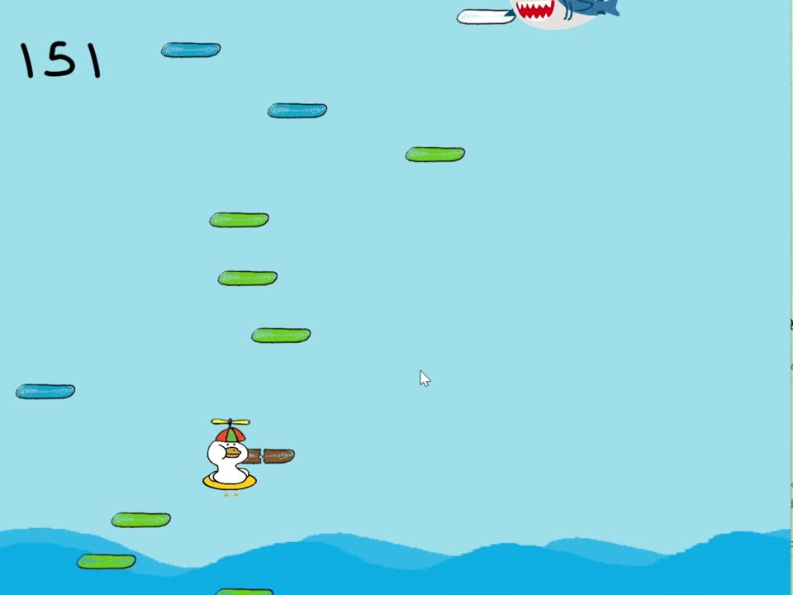
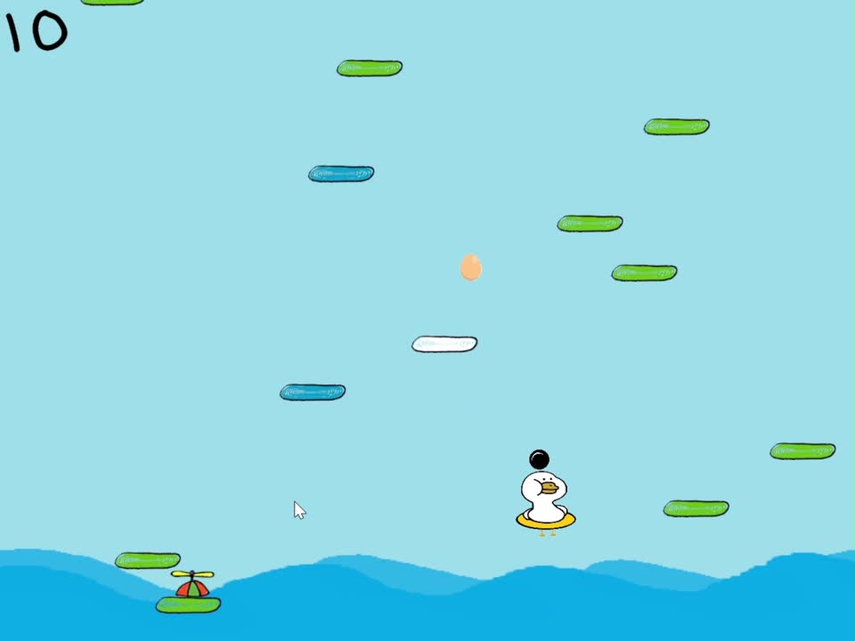
Game Play
Jump
Collect item
Avoid or fight with sea creatures
5

Slide 6
Goals
Redesign an old game, creating an entertaining experience.
Apply Object-Oriented Programming (OOP) principles:
-Abstraction
-Polymorphism
-Inheritance
-Encapsulation
6

Slide 7
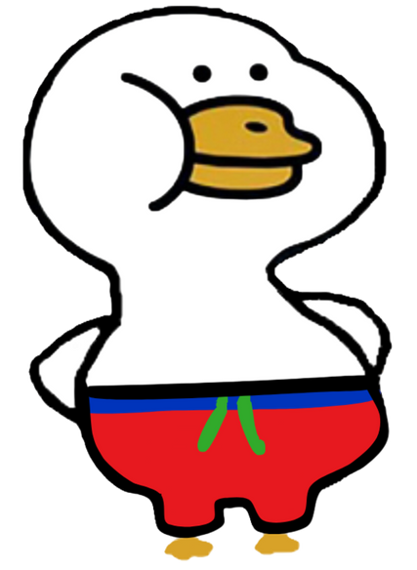
Literature Review
7

Slide 8

Directions
There are 2 development directions:
Criteria | Web-based Game | Desktop Game
Performance | Limited by browser | High, utilizes hardware fully
Graphics & Sound | Basic | Supports complex, vibrant effects
Reach | High, playable directly on the web | Dependent on operating system
Security | Harder to control | Better, with anti-piracy features
8

Slide 9

Analysis and design
9

Slide 10


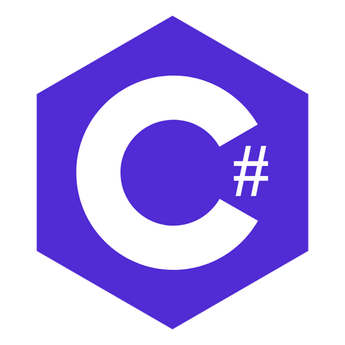

Tool and Resource
10

Slide 11
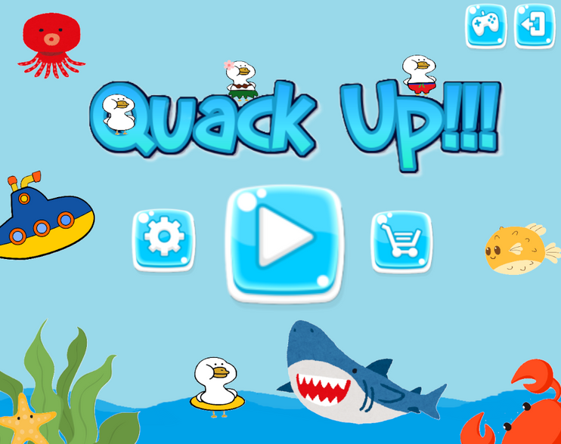
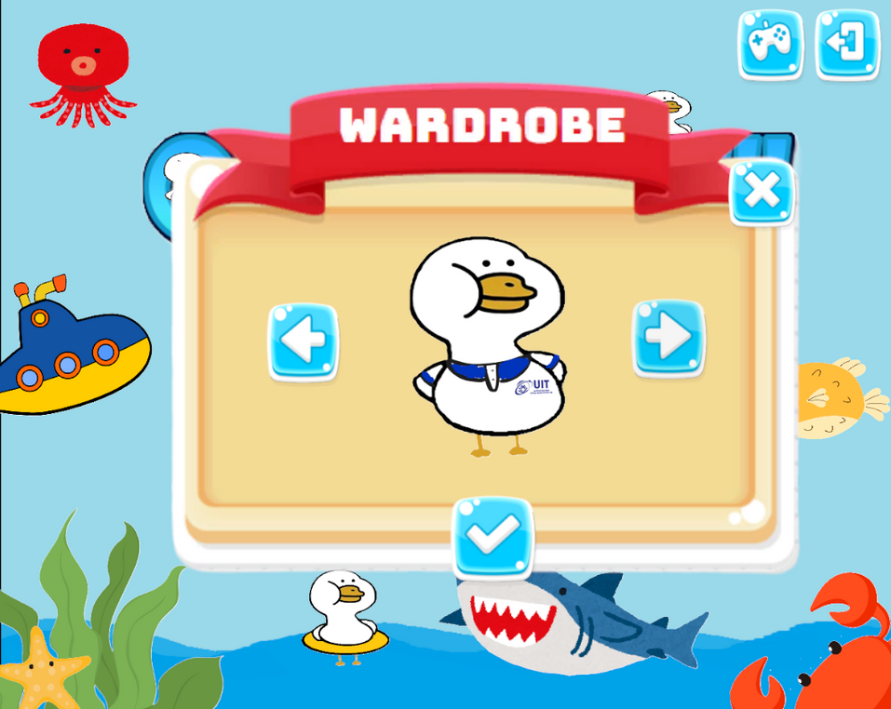
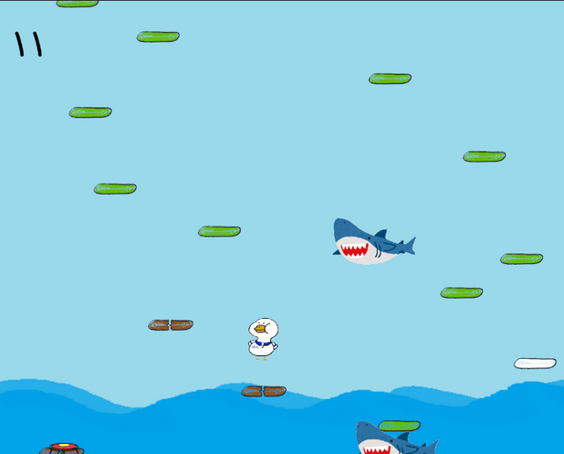
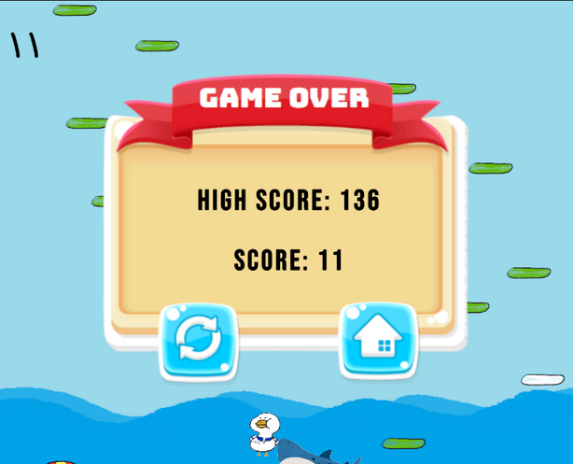
UI/UX
11

Slide 12

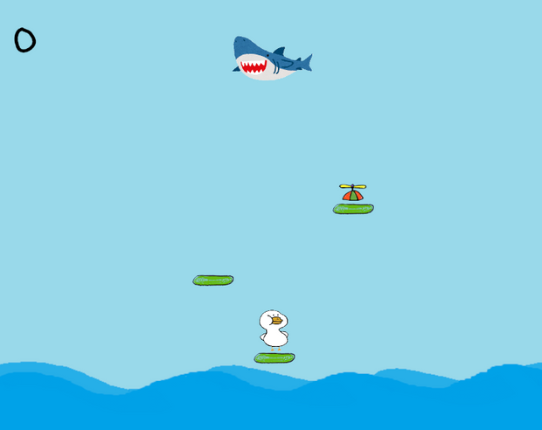
UI/UX
Score
Tutorial
Enemy
Quit game
Boost
Audio Setting
Skin Setting
Main Character
Menu
In Game
12

Slide 13
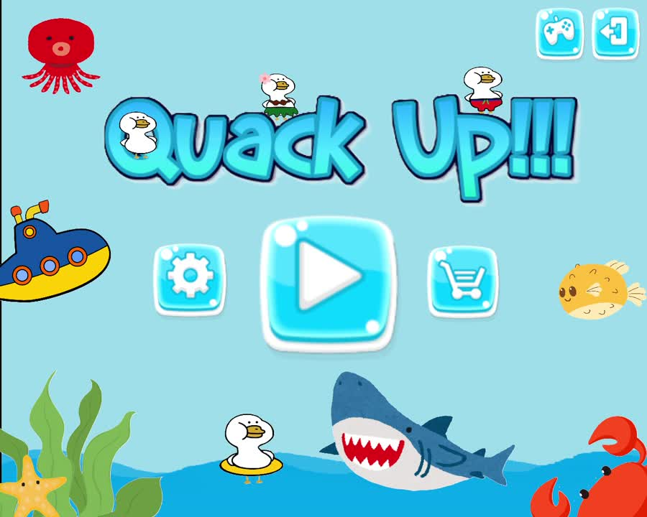
Game Logic
13

Slide 14
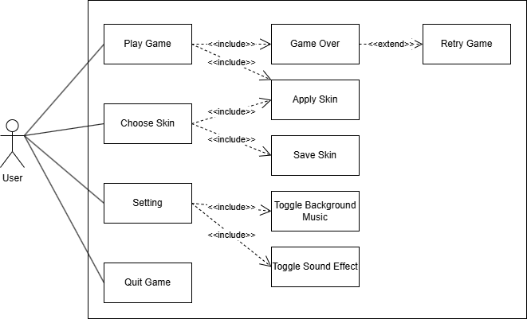
Use Case
14

Slide 15
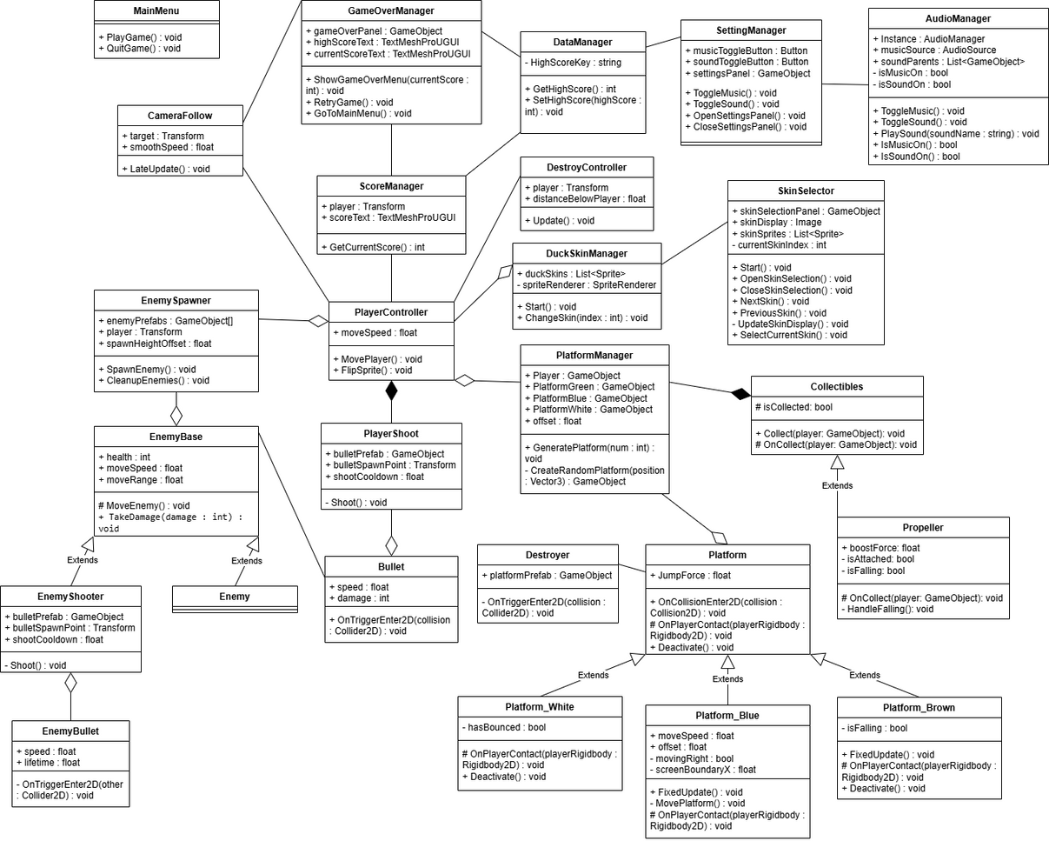
Class Diagram
15

Slide 16
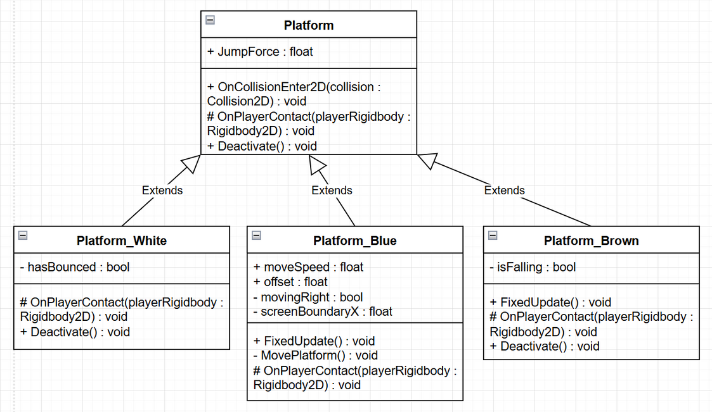
Abstraction
Class Platform:
Defines common behaviors such as OnPlayerContact and Deactivate.
Subclasses override these methods to customize the logic without rewriting everything from scratch.
16

Slide 17
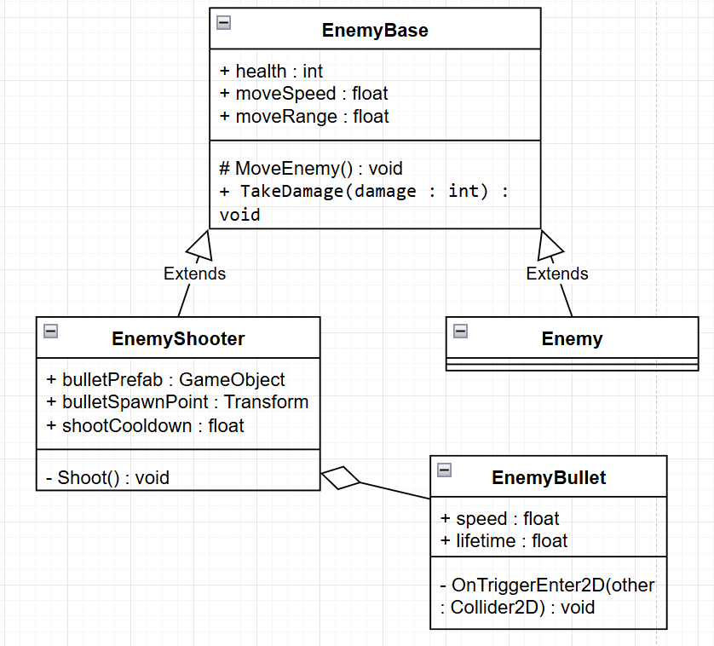
Inheritance
Class EnemyBase:
Subclasses such as Enemy and EnemyShooter inherit movement logic (MoveEnemy) and damage handling (TakeDamage) from the parent class without needing to reimplement them.
17

Slide 18
Polymorphism
OnPlayerContact method in class Platform:
Each subclass overrides this method to define unique interactions between the platform and the player upon collision, such as bouncing, self-destruction, or falling.
18

Slide 19
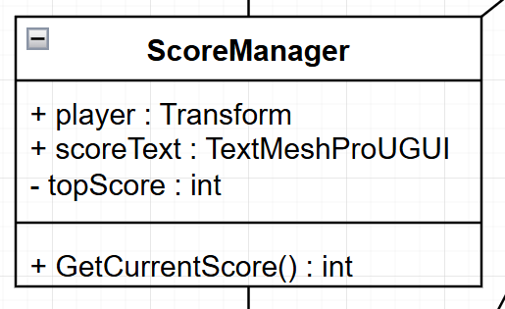
Encapsulation
Class ScoreManager:
The topScore attribute is encapsulated by declaring it as private.
It can only be accessed or updated through public methods like GetCurrentScore, ensuring controlled and secure access to the score data.
19

Slide 20
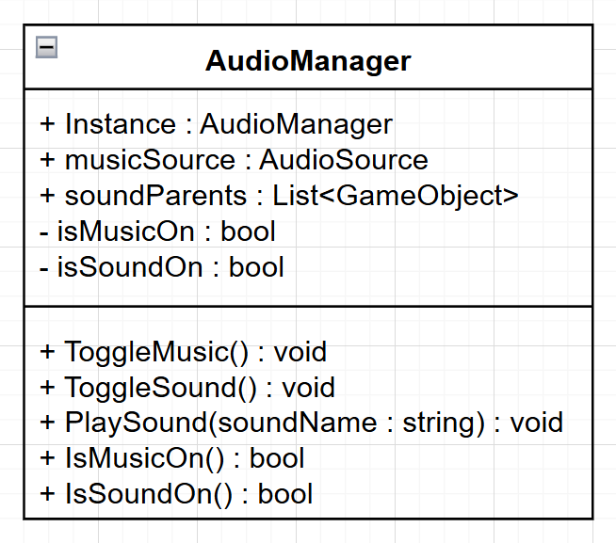
Singleton Pattern
Ensures centralized management of audio by guaranteeing only one instance exists in the application
Simplifies global audio control.
Ensures consistent settings across the app.
20

Slide 21
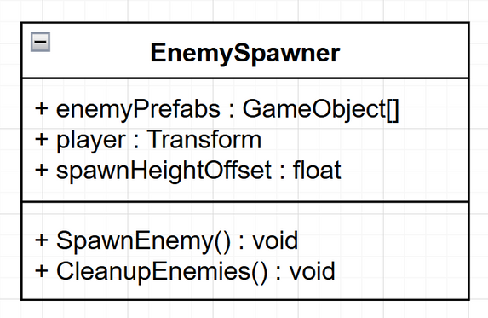
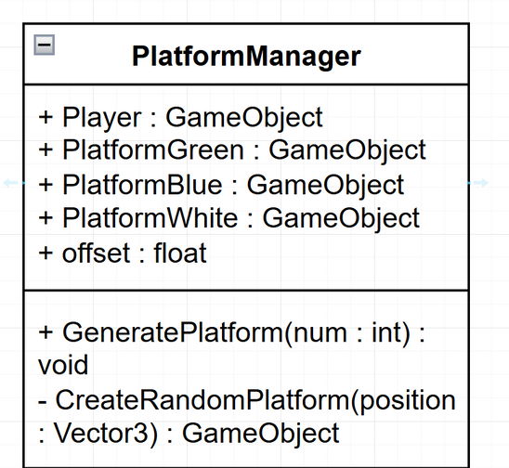
Factory Pattern
Generates objects dynamically like platforms and enemies based on specific needs.
Makes it easy to manage diverse object creation.
Reduces manual coding for repetitive instantiation.
21

Slide 22
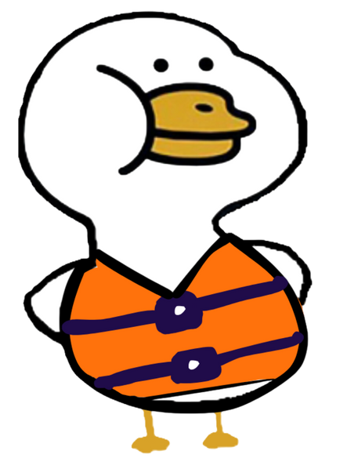
Development
22

Slide 23
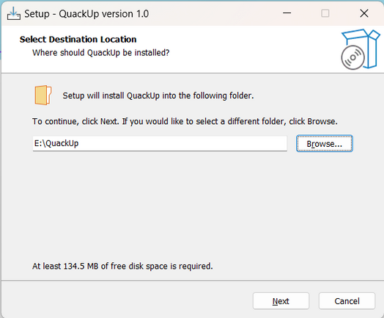
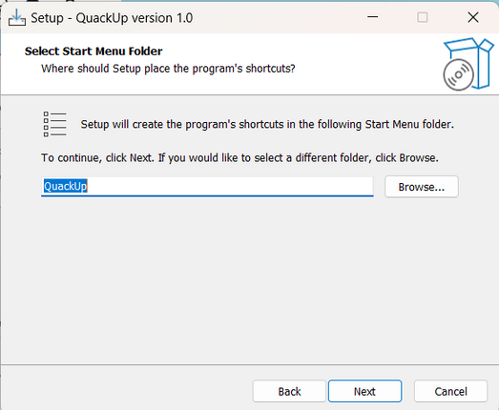
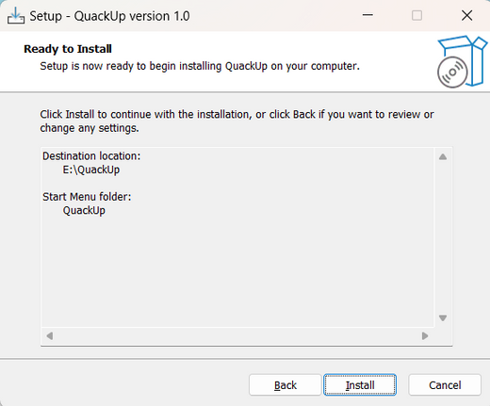
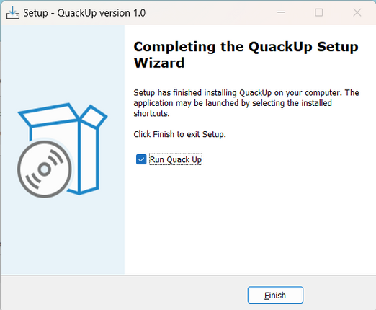
Download
23

Slide 24

Special Features
24

Slide 25
Special feature
Customizable Characters
Function: Let players change the character's appearance with skins.
Benefits:
Personalizes gameplay experience and retains player preferences.
How It Works:
Dynamic sprite-based customization.
Intuitive UI for skin selection.
Saves skin choice using PlayerPrefs.
25

Slide 26
Special feature
Dynamic Object Management
Function: Dynamically spawns platforms and enemies based on the player's position.
Benefits:
Provides unique gameplay experiences through random spawning.
Enhances performance by removing off-screen objects.
How It Works:
Platforms and enemies are spawned randomly as the player progresses.
Off-screen objects are identified and removed to optimize resource usage.
26

Slide 27
Special feature
Challenges:
Avoid overlapping or misplaced objects.
Manage performance as object count increases.
Solutions:
Use HashSet to prevent duplicate platform positions.
Clean up off-screen objects with methods like CleanupEnemies or DestroyController.
Adjust spawning parameters to balance performance and gameplay.
27

Slide 28
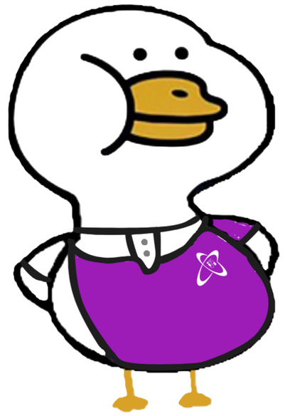
Conclusion
28

Slide 29
Complete task
Created a friendly, dynamic interface with essential buttons.
Added skin selection for character customization.
Improved gameplay with enemy shooting and battles.
Applied OOP principles to ensure scalability and maintainability.
29

Slide 30
Future plan
Add multiple levels
Improve enemies and platforms generation in a less random way.
Increase difficulty with enemies and special items.
Introduce new items: Shields, speed boosts, and enemy effects.
30

Slide 31

Demo
31

Slide 32
Resource
Link download : https://bit.ly/3ZuPcxQ
Link Github: https://bit.ly/4gnyQh0
32

Slide 33
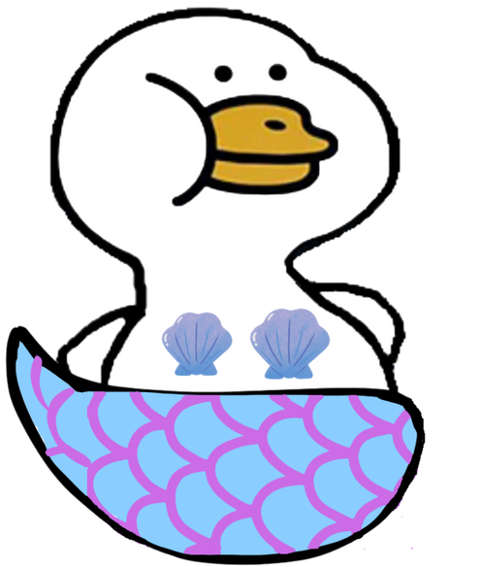
Thank you
33

